Slide 1
Introduction to Databases CT042-3-1-IDB
Lecture 3: Data Model

Slide 2
Topic & Structure of The Lesson
Data model
Business rules
Relational model
Entity Relationship Model

Slide 3
Learning Outcomes
At the end of this topic, You should be able to
Describe types of data model
Write business rules
Understand entity relationship model

Slide 4
Key Terms You Must Be Able To Use
If you have mastered this topic, you should be able to use the following terms correctly in your assignments and exams:
Data model
Business rules
ERD

Slide 5
In this chapter, you will learn:
Why data models are important
About the basic data-modeling building blocks
What business rules are and how they influence database design
How the major data models evolved

Slide 6
The Importance of Data Models
Data models (representation of data)
Relatively simple representations, usually graphical, of complex real-world data structures
Facilitate interaction among the designer, the applications programmer, and the end user
A data model is a structured framework for organizing and defining data elements and their relationships, used to support data storage, retrieval, and management within a system.
An example of a data model is the relational model used in databases like MySQL. In this model, data is organized into tables (relations) with rows and columns, where each table represents an entity (e.g., "Customers") and columns define attributes (e.g., "CustomerID," "Name," "Email"). Relationships between tables are established using keys, like primary and foreign keys, to connect related data across tables.

Slide 7
The Importance of Data Models (continued)
End-users have different views and needs for data
Data model organizes data for various users

Slide 8
Data Model Basic Building Blocks
Entity - anything about which data are to be collected and stored
Attribute - a characteristic of an entity
Relationship - describes an association among entities
One-to-many (1:M) relationship (parent child)
Many-to-many (M:N or M:M) relationship(courses and teachers)
One-to-one (1:1) relationship(student and id, user and profile)
Constraint - a restriction placed on the data

Slide 9
Business Rules
Brief, precise, and unambiguous descriptions of a policies, procedures, or principles within a specific organization
Apply to any organization that stores and uses data to generate information
Description of operations that help to create and enforce actions within that organization’s environment

Slide 10
Business Rules (continued)
Should be rendered in writing
Must be kept up to date
Sometimes are external to the organization
Must be easy to understand and widely disseminated
Describe characteristics of the data as viewed by the company

Slide 11
Discovering Business Rules
Sources of Business Rules:
Company managers
Policy makers
Department managers
Written documentation
Procedures
Standards
Operations manuals
Direct interviews with end users

Slide 12
Discovering Business Rules (continued)
Generally, nouns translate into entities
Verbs translate into relationships among entities
Relationships are bi-directional

Slide 13
The Evolution of Data Models (continued)
Hierarchical
Network
Relational
Entity relationship

Slide 14
Data Models
A collection of tools for describing
Data
Data relationships
Data semantics
Data constraints
Relational model
Entity-Relationship data model (mainly for database design)
Object-based data models (Object-oriented and Object-relational)
Semi-structured data model (XML)
Other older models:
Network model
Hierarchical model

Slide 15
Hierarchical Data Model:
A hierarchical database model is a data model in which the data is organized into a tree-like structure.
Represents data in a tree-like structure where there is a single parent for each record and records are connected in a one-to-many relationship.
The structure allows representing information using parent/child relationships: each parent can have many children, but each child has only one parent.
Key Characteristics:
Each child node has only one parent.
Data retrieval follows a top-down approach.
Relationships are predefined, making it rigid.

Slide 16
Hierarchical Data Model:
The strongest advantage of the hierarchical database approach is the speed and efficiency with which it can be searched for data.
The hierarchical model does have problems: Access to data in this model is predefined by the database administrator before the programs that access the data are written. Programmers must follow the hierarchy established by the data structure.
It can not handle many to many relationship

Slide 17
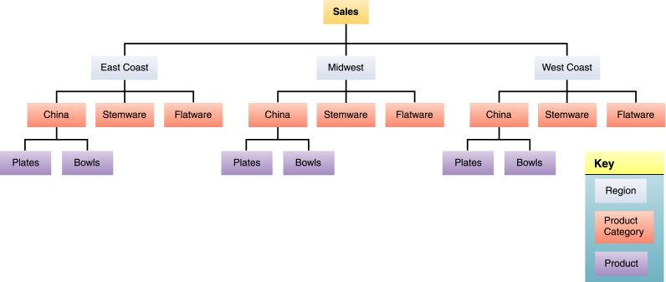
Hierarchical Data Model:

Slide 18
Network Data Model:
The network model is a database model conceived as a flexible way of representing objects and their relationships.
Represents data in a graph-like structure where records can have multiple parent and child nodes, allowing many-to-many relationships.
Unlike hierarchical model, the network model allows each record to have multiple parent and child records, forming a lattice structure.
The network model replaces the hierarchical tree with a graph allowing more general connections among the nodes.
This model was evolved to specially handle non-hierarchical relationships.
Data retrieval can follow a bottom-up, top-down, or lateral approach.

Slide 19
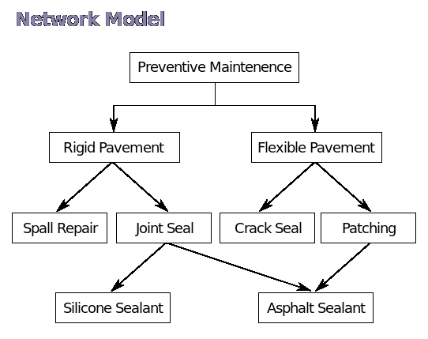
Network Data Model:
Support many-to-many relationship
Good processing speed but very complex model to design, implement and maintain
Students enrolled in multiple courses. Professors teach multiple courses, and students interact with professors across courses and vice versa.(university system)

Slide 20
Relational Data Model
Relational data model represents the database as a collection of relations where each relation resembles a table of values with rows and columns.
A relation may be regarded as a set of tuples, also called records. A relation consists of relation schema & relation instance. The relation schema specifies relation name & description of tuples (name of attributes, domain). While relation instance corresponds to a table of rows & columns where each row is a tuple & the column is the attribute.
Major advantages of relational model over the older data models are the simple data representation & the ways complex queries can be expressed easily.

Slide 21
Relational Data Model
Consider a relation representing employee record as;
Employee
The relational model of data permits the database designer to create a consistent, logical representation of information. Consistency is achieved by including declared constraints in the database design, which is usually referred to as the logical schema. The theory includes a process of database normalization whereby a design with certain desirable properties can be selected from a set of logically equivalent alternatives
Eid | Name | Address | Depart_no
011 | Ram Sing | Kathmandu | D01
012 | Hari Saha | Pokhara | D02

Slide 22
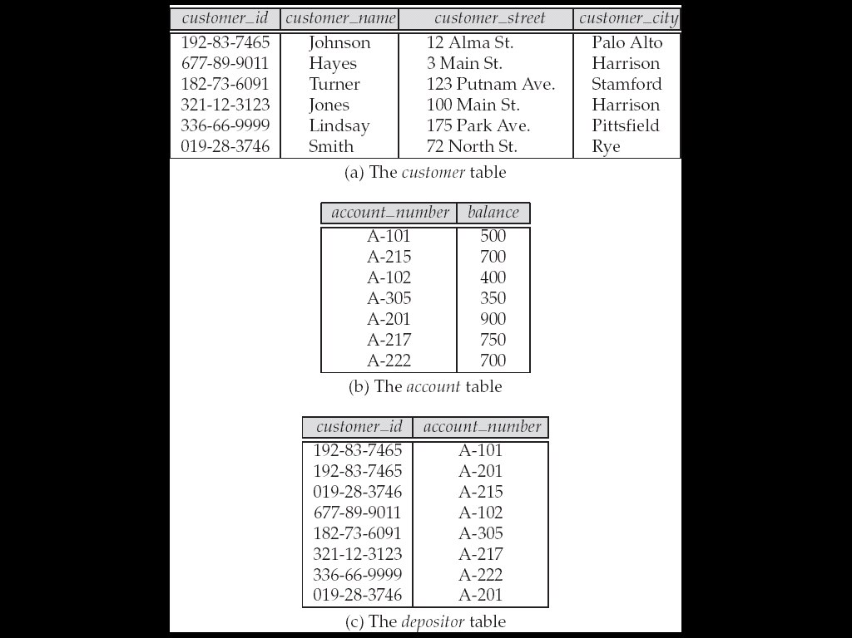
Fig: A Sample Relational Database

Slide 23
The relational data model is the most widely used data model, and a vast majority of current database systems are based on the relational model.
The relational model is at a lower level of abstraction than the E-R model.
Database designs are often carried out in the E-R model, and then translated to the relational model.

Slide 24
Entity-Relationship Model:
The entity-relationship (E-R) model is a high level data model based on a perception of a real world that consists of collection of basic objects, called entities, and of relationships among these entities. An entity is a thing or object in the real world that is distinguishable from other objects.
Entities are described in a database by a set of attributes. A relationship is an association among several entities.
The set of all entities of the same type is called an entity set and the set of all relationships of the same type is called a relationship set.

Slide 25
The overall logical structure of a database can be expressed graphically by an E-R diagram. The components of this diagram are:
• Rectangles (represent entity sets)
• Ellipses (represent attributes)
• Diamonds (represent relationship sets among entity sets)
• Lines (link attributes to entity sets and entity sets to relationship sets)

Slide 26
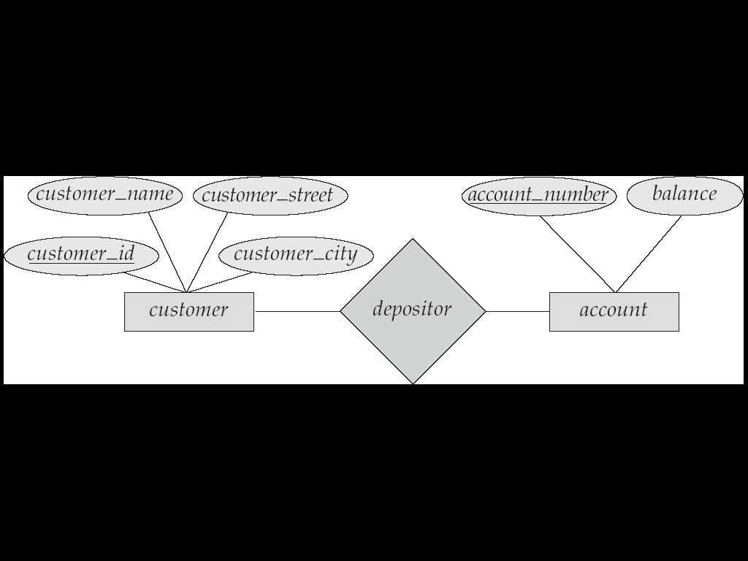
Fig: A Sample E-R Diagram

Slide 27
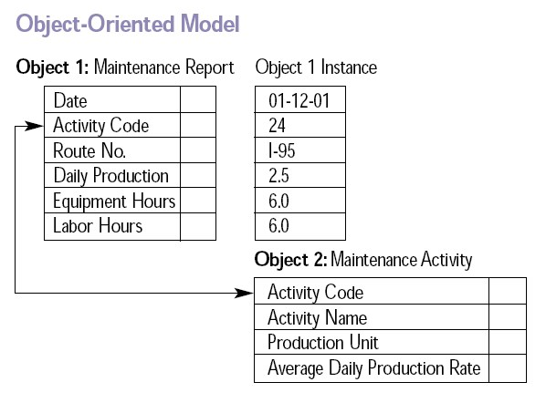
Object Oriented Database: An object database (also object-oriented data model) is a database model in which information is represented in the form of objects as used in object-oriented programming.
Data model that adds new object storage capabilities to relational databases.

Slide 28
Entities Relationship Model
The entity-relationship (E-R) model is a high level data model based on a perception of a real world that consists of collection of basic objects, called entities, and of relationships among these entities.
An entity is a thing or object in the real world that is distinguishable from other objects.
Entities are described in a database by a set of attributes.
A relationship is an association among several entities.
The set of all entities of the same type is called an entity set and the set of all relationships of the same type is called a relationship set.
ER Model is logical modeling of a database.

Slide 29
Entities and Attributes
Entity is a thing in real world with and independent existence that is distinguishable from all other objects. An Entity may be an object with physical existence like person, vehicle etc. or may be an object with conceptual existence like account, course etc.
Each entities have certain kind of properties that gives proper identification to each of entity. Thus, attributes are the properties that describe the entity. Each entity has value for each of its attributes. Thus, for each attribute there is a set of permitted values known as Domain. Hence attribute of an entity set can be defined as a function that maps from the entity set to a domain. Example:
Entity:- Employee
Attributes:- Employee_id, Name, Salary, Age, Phone
An instance of entity Employee will be defined once certain values will be assigned to the given attributes.

Slide 30
Attribute Types…..
Attributes can be of following types;
Simple vs. Composite
Single Valued vs. Multi-valued
Stored vs. Derived
Null Valued
Simple Vs. Composite:-
Simple are those that are not divisible. They are also known as “atomic attributes”.
Composite attributes are those that are made up of one or more simple or composite attributes & hence are divisible to smaller subparts. Composite attributes can form a hierarchy.
Eg: Address can be the composite attribute as it can be subdivided into Streetaddress, City, State.
Similarly, Name can be divided as Fname, Lname. But Fname, Lname themselves are simple.

Slide 31
Attribute Types…..
Single Valued vs. Multi-valued:-
Single valued are those having just a single value, for a particular entity, from the permitted domain.
Multi-valued are those that can have a set of values for same entity.
Eg: Roll_no, age can be considered as single valued. While Phone_no, College_degree can have multiple values, so are multivalued.
Stored vs. Derived:-
An attribute whose value can be derived from or inferred from the value of another attribute, then it is derived otherwise it is stored. For example, Age attribute is derived as it can be inferred from the Date_of_birth attribute which is stored.
Null Valued:-
Are those attributes that do not have any applicable values. The null values can also be used if we do not know the value of an attribute for a particular entity.

Slide 32
Relationship
Relationship is an association among several entities.
Relationships can be thought of as verbs, linking two or more nouns. Examples: a teaches relationship between a teacher and a student, a supervises relationship between an employee and a department etc.
Jagdish Bhatta
32
Notes:
Jagidsh Bhatta
32

Slide 33
Relationship Degree, Role Names & Recursive Relationships
Degree of relationship type:- The degree of relationship type is the number of participating entity types. Relationships can generally be of any degree, but the most common ones are binary relationships. i.e. having two participating entity types.
having three participating entity types - Ternary relationship
having n participating entity types – n-ary relationship
Jagdish Bhatta
33
Notes:
Jagidsh Bhatta
33

Slide 34
Relationship Degree, Role Names Contd……..
Departments
Employee
employer
Role
Names
Recursive
Relationship
Supervisor
Works_In
Subordinate
worker
Supervises
Employees
Fig 1: Role Names Fig 2: Recursive Relationship
The relationship in Fig. 1 has degree 2, so a binary relationship. While in Fig. 2 the degree is 1, so a unary relationship.
Jagdish Bhatta
34
Notes:
Jagidsh Bhatta
34

Slide 35
Entities types and Entity sets
Entity Types: Entity type defines a collection of entities that have same attributes, but each entity has its own value for each attributes. An entity type describes the schema for a se of entities that share same structure.
Entity Sets: An entity set is a set of entities of the same type that share the same properties, or attributes
i.e. the collection of all the entities of particular type in the database at any instance is called the entity set. The entity set is usually referred to using the same name as entity type.
In the process of modeling, we often use the term entity set is abstract, without referring to a particular set of individual entities.

Slide 36
Entities types and Entity sets
Example:
Employee Entity Type
Employee_id, Name, Salary
(01, John, 20000)
(02, Adam,12000) Entity Set
……
…...
Extension / Entity Instance

Slide 37
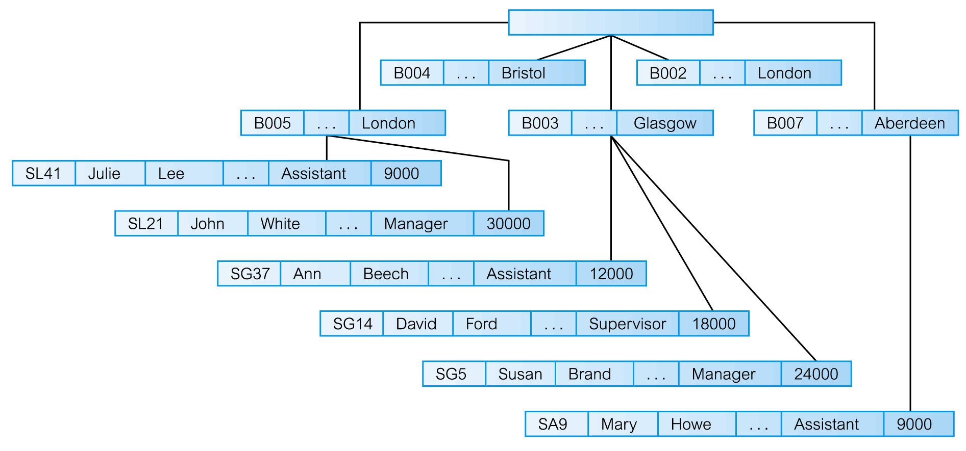
The Hierarchical Data Model

Slide 38
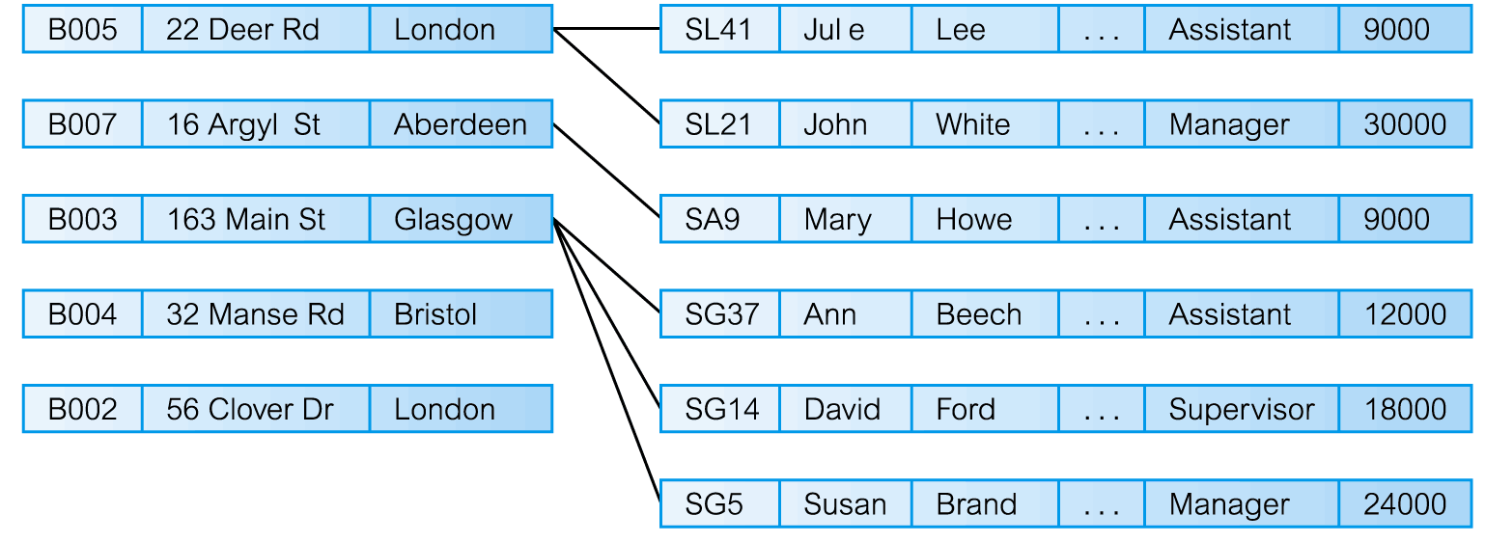
The Network Model

Slide 39
The Relational Model
Developed by Codd (IBM) in 1970
Considered ingenious but impractical in 1970
Conceptually simple
Computers lacked power to implement the relational model
Today, microcomputers can run sophisticated relational database software

Slide 40
The Relational Model (continued)
Table (relations)
Matrix consisting of a series of row/column intersections
Related to each other through sharing a common entity characteristic
Relational diagram
Representation of relational database’s entities, attributes within those entities, and relationships between those entities

Slide 41
The Relational Model (continued)
Relational Table
Stores a collection of related entities
Resembles a file
Relational table is purely logical structure
How data are physically stored in the database is of no concern to the user or the designer
This property became the source of a real database revolution

Slide 42
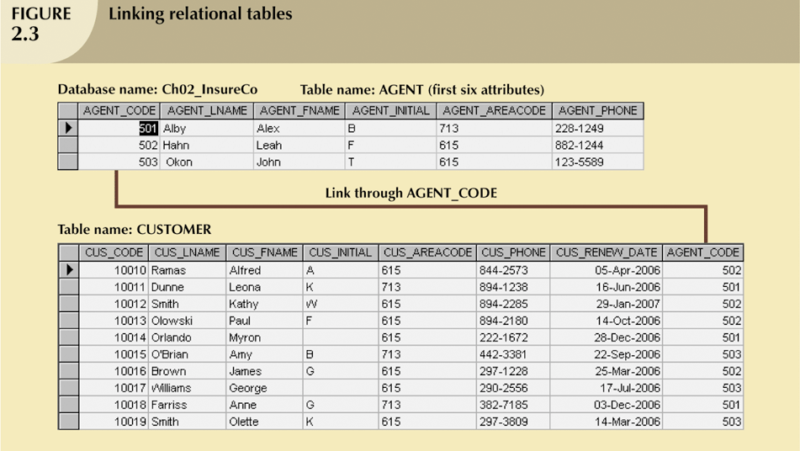
The Relational Model (continued)

Slide 43
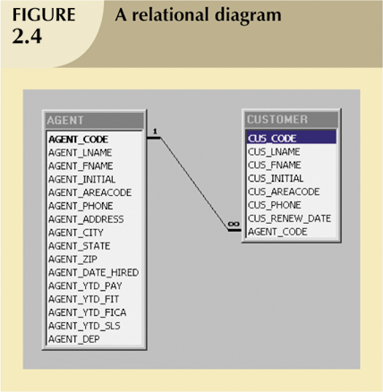
The Relational Model (continued)

Slide 44
The Entity Relationship Model
Widely accepted and adapted graphical tool for data modeling
Introduced by Chen in 1976
Graphical representation of entities and their relationships in a database structure

Slide 45
The Entity Relationship Model (continued)
Entity relationship diagram (ERD)
Uses graphic representations to model database components
Entity is mapped to a relational table
Entity instance (or occurrence) is row in table
Entity set is collection of like entities
Connectivity labels types of relationships
Diamond connected to related entities through a relationship line

Slide 46
Story for an ER Diagram: Student Attendance System
At a university, the administration wants to implement a system to manage student attendance. The system should ensure accurate tracking of classes, students, and attendance records to improve monitoring and reporting.
The university consists of students, courses, and teachers. Each student is enrolled in multiple courses, and each course is taught by a teacher.

Slide 47
Entities
Students:
Each student has a unique Student ID, along with attributes like name, email, contact number, and batch.
Teachers:
Teachers manage classes and maintain attendance. Each teacher has a unique Teacher ID, along with their name, email, and department.
Courses:
Each course is identified by a Course ID and includes attributes like course name, description, and the number of credits.
Attendance Records:
Attendance is tracked for each student in a specific course on a specific date. The record includes attributes like Attendance ID, attendance date, and status (Present/Absent).

Slide 48
Entities…
Class Schedule:
Each course has a class schedule with attributes such as class time, day of the week, and location.

Slide 49
Relationships:
A student can enroll in multiple courses, and a course can have multiple students.
A teacher teaches one or more courses, but each course is taught by only one teacher.
Each attendance record links a specific student to a specific course for a given date.
A class schedule is associated with each course to indicate when and where classes are held

Slide 50
Example
John, a computer science student, is enrolled in courses like "Database Management" and "Operating Systems," taught by Prof. Smith. Each week, John attends these classes according to the defined schedule. The system tracks whether John attended each class and stores the information for reporting and analysis.

Slide 51
Banking System ER Model
In a bustling city, there is a bank named Global Trust Bank. The bank serves thousands of customers who visit various branches spread across the country. Each branch is identified by a unique Branch ID and managed by a branch manager, and it maintains records like the branch name, address, and contact details. Every branch employs several employees who assist customers with their banking needs, from opening accounts to approving loans.
Each customer is uniquely identified by a Customer ID. Customers provide personal details such as their name, contact information, and address when they register. A customer can open one or more accounts at the bank, such as savings accounts, checking accounts, or fixed deposits. Each account is assigned an account number, and details like account type and balance are recorded.

Slide 52
Scenario..
Transactions happen daily at the bank. These transactions are associated with specific accounts, detailing the date, type (withdrawal, deposit, or transfer), and amount involved. A single account can have numerous transactions, but each transaction belongs to only one account.
The bank also offers various loan services, including personal loans, home loans, and car loans. A loan is uniquely identified by a Loan ID and has attributes like loan type, amount, interest rate, and repayment schedule. Customers apply for loans, and once approved, the loan details are linked to their accounts. While a customer can take multiple loans, each loan is associated with only one customer.

Slide 53
Scenario..
The branches also play a role in loan approvals. Each branch manages several loans, ensuring that proper records are maintained. Furthermore, employees are assigned to specific branches, but they may assist customers across multiple locations.
Lastly, the customers are the heart of the system. They interact with employees for queries or assistance, ensuring smooth banking operations. The relationships between these entities — customers, accounts, transactions, loans, branches, and employees — form the backbone of the bank's operations, ensuring seamless financial services to all.

Slide 54
Entities
Customer
Attributes: Customer ID (primary key), Name, Address, Contact Number, Email, Date of Birth.
Branch
Attributes: Branch ID (primary key), Branch Name, Location, Contact Number, Manager Name.
Account
Attributes: Account Number (primary key), Account Type (e.g., Savings, Checking), Balance, Date Created.

Slide 55
Entities..
Transaction
Attributes: Transaction ID (primary key), Transaction Type (e.g., Deposit, Withdrawal), Date, Amount.
Loan
Attributes: Loan ID (primary key), Loan Type (e.g., Personal, Home, Car), Amount, Interest Rate, Repayment Schedule.
Employee
Attributes: Employee ID (primary key), Name, Role, Contact Number, Assigned Branch.

Slide 56
Relationship ..
Customer ↔ Account
Relationship: A customer can have multiple accounts (1:N), but each account belongs to only one customer.
Account ↔ Transaction
Relationship: An account can have multiple transactions (1:N), but each transaction is associated with one account.
Customer ↔ Loan
Relationship: A customer can take multiple loans (1:N), but each loan is linked to one customer.

Slide 57
Relationship cont..
Branch ↔ Account
Relationship: A branch can manage multiple accounts (1:N), but each account is associated with one branch.
Branch ↔ Loan
Relationship: A branch can approve multiple loans (1:N), but each loan is managed by one branch.
Branch ↔ Employee
Relationship: A branch employs multiple employees (1:N), but each employee works in one branch.
Employee ↔ Customer
Relationship: An employee assists multiple customers (1:N), and a customer may interact with multiple employees (M:N).

Slide 58
Summary:
Entities: Customer, Branch, Account, Transaction, Loan, Employee.
Attributes: Each entity has its own set of descriptive attributes, as listed above.
Relationships: The story defines key interactions like 1:N and M:N relationships between entities.

Slide 59
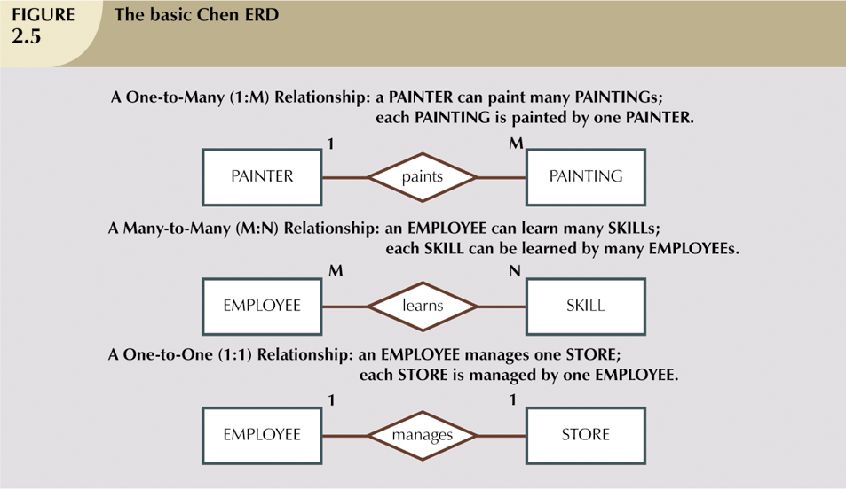
The Entity Relationship Model (continued)

Slide 60
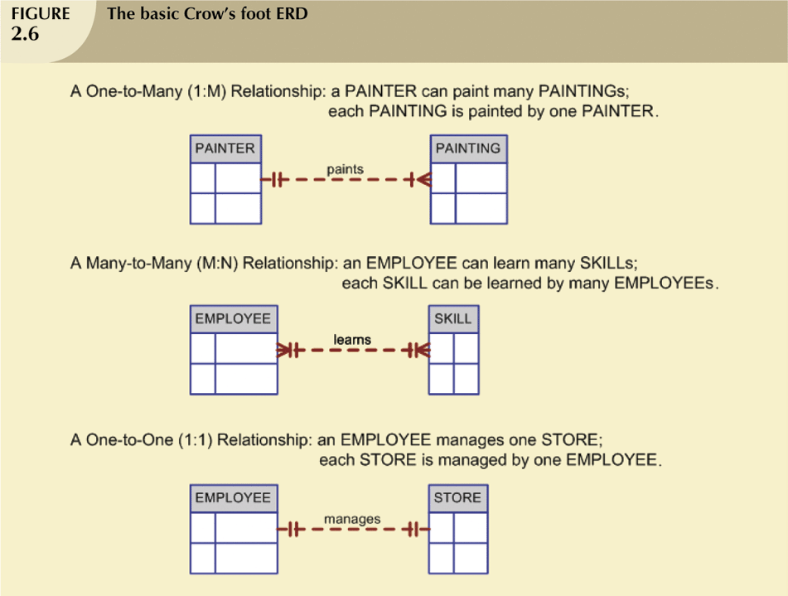
The Entity Relationship Model (continued)

Slide 61
Quick Review Question
What is data model?
What is the source of business rules?
What is entity relationship model?

Slide 62
Summary of Main Teaching Points
Data models are simple representations, usually graphical, of complex real-world data structures
Business rules are brief, precise, and unambiguous descriptions of a policies, procedures, or principles within a specific organization.
Entity relationship models are graphical representation of entities and their relationships in a database structure

Slide 63
Question and Answer Session
Q & A

Slide 64
What we will cover next
Characteristics of relational table
Different types of keys
Integrity rules
Data dictionary

